Slide 1


Bangalore Institute of Technology
Department of Artificial Intelligence and Machine Learning
Human Scream Detection using Machine Learning and Deep Learning
Faculty Coordinator – Mrs. Subha Meenakshi
Team Members :-
Sanjana S - 1B120AI042
Vignesh R S - 1B120AI052

Slide 2

Abstract
Scream detection holds significance in various applications, including public safety, emergency response, and surveillance. Leveraging deep learning models, particularly neural networks, the system aims to accurately identify and classify human screams from audio data. The implementation involves dataset curation, model training, and evaluation to achieve robust performance in real-world scenarios. The outcome of this project contributes to enhancing the efficiency of scream recognition systems for applications like security, disaster response, and public safety.

Slide 3
Introduction
In contemporary technological landscapes, the demand for robust audio-based systems has surged, particularly in contexts where human safety is paramount. Recognizing the urgency in situations where individuals emit screams, often indicative of distress or emergencies, this project delves into the development of a Human Scream Detection System. Traditional methods face limitations in accurately discerning and classifying scream sounds, motivating the adoption of deep learning, specifically neural networks, known for their ability to capture intricate patterns in complex data.
This project employs the ResNet-34 architecture, a robust convolutional neural network, for human scream detection, enhancing safety and emergency response systems. By leveraging ResNet-34's depth and feature extraction capabilities, the project seeks to improve the accuracy of identifying subtle audio patterns associated with distress signals. The subsequent sections delve into dataset preparation, model architecture, and evaluation processes, showcasing the adaptability of ResNet-34 in addressing the complexities of human scream recognition.

Slide 4
Literature Survey
S.No | Authors name & Year of Publications | Title name & Journal Name | Abstract or objectives | Techniques Used | Limitations
1 | Sukhwan Chung and Yongjoo Chung May 3-4, 2017 | Scream sound detection based on SVM and GMM 7th BANGKOK International Conference on “Recent Trends in Engineering and Technology” (RTET-17) | Develop a system that can detect scream sounds in real-time to aid in crime rate control. | Audio analysis methods, SVM, and GMM classifiers. The study compares the performance of SVM and GMM classifiers through various experiments. | The paper's imitations include a specific focus on certain environments, potential oversights in scream sound variations, and a lack of comprehensive exploration of false positives. Additionally, the absence of real-time implementation and ethical considerations could impact the practical applicability of the proposed detection methods.
2 | Ji-Hun Seo, Hye-In Lee, Seok-Pil Lee November 2014 | A Design of a Scream Detecting Engine for Surveillance Systems The Transactions of The Korean Institute of Electrical Engineers | This paper proposes a scream detecting engine for surveillance systems that can detect screams from various ambient noises in real environments. | The paper may explore methodologies such as signal processing, pattern recognition, or machine learning to achieve accurate scream detection. | The proposed scream detecting engine for surveillance systems faces challenges such as limited training data diversity, potential false positives/negatives, and privacy concerns. Real-time processing complexity and adaptability to unknown scream variations, along with integration and maintenance issues, are additional limitations that need careful consideration for effective deployment. Addressing these challenges and ensuring ethical use are vital for the system's reliability and acceptance in diverse environments.
3 | Fairuz Samiha Saeed, Abdullah Al Bashit, Vishu Viswanathan and Damian Valles September 2021 | An Initial Machine Learning-Based Victim’s Scream Detection Analysis for Burning Sites Appl. Sci. | Investigate two machine learning methods, support vector machine (SVM) and convolutional neural network (CNN), for scream detection. | SVM and CNN. | Reliance on a balanced dataset, potential challenges in rare real-world scream occurrences, and a lack of explicit consideration for environmental factors or ethical concerns associated with deploying autonomous vehicles for scream detection in fire emergencies. Additionally, the untested real-time implementation on the Jetson Nano platform and future plans to attach a microphone introduce uncertainties in the model's practical applicability and data collection in dynamic situations.

Slide 5
S.No | Authors name & Year of Publications | Title name & Journal Name | Abstract or objectives | Techniques Used | Limitations
4 | Ashutosh Shankhdhar, Rachit, Vinay Kumar, and Yash Mathur June 2021 | Human Scream Detection Through Three-Stage Supervised Learning and Deep Learning Springer Link | The paper states that audio and video signals are crucial for understanding situations, characters, time, and place. The study focuses on detecting screams and shouts from speech and noise using pure SVM-based classifiers. The paper demonstrates that the system can achieve a 90% accuracy in detecting distress sounds. | SVM-based classifiers and deep learning methods. | Limitations of audio detection systems include the complexity of audio signals, the need for large amounts of labeled data for training, and the challenges in handling noisy and dynamic environments.
5 | Weimin Huang, Tuan Kiang Chiew, Haizhou Li, and Tian Shiang Kok July 2010 | Scream detection for home applications Industrial Electronics and Applications (ICIEA), 2010 the 5th IEEE Conference | Develop a system that can detect screams in continuous speech for various applications, including home monitoring, public security, and safety surveillance. | The techniques used in the study are analytic and statistical features for classification, and the log energy to detect the energy continuity of the audio to represent the screaming. | The proposed scream detection method exhibits limitations in generalization to diverse environments, potential sensitivity to background noise, and underscores the need for a more extensive and varied database to enhance robustness across different scream variations and environmental conditions.

Slide 6
Proposed System
The proposed system utilizes advanced audio signal processing techniques and machine learning algorithms to detect human screams in real-time. By analyzing key acoustic features such as pitch, intensity, and duration, the system achieves high accuracy in distinguishing screams from background noise. It employs a trained neural network model to classify scream patterns, enabling prompt identification and response. The system's versatility allows integration into various applications, including security systems, emergency response mechanisms, and smart home devices. It prioritizes both sensitivity and specificity, minimizing false positives while ensuring rapid and reliable scream detection. Additionally, the system can be fine-tuned for different environmental conditions, making it adaptable to diverse settings. Its efficient design enables low-latency performance, enhancing its effectiveness in time-critical scenarios. The proposed system offers a robust solution for automating scream detection, contributing to enhanced safety and security across multiple domains.

Slide 7

Problem Statement
Human Scream Detection for Controlling Crime Rate using Deep Learning Models in such a way that it can be used to save someone’s life in a predicament

Slide 8
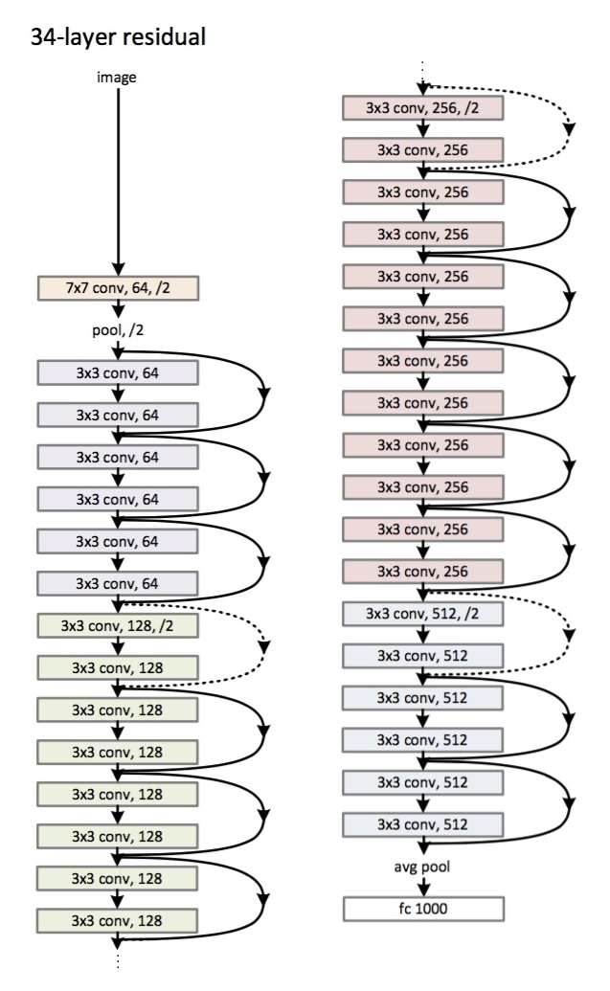
Architecture of Resnet-34
Initially, we have a convolutional layer that has 64 filters with a kernel size of 7×7 this is the first convolution, then followed by a max-pooling layer. We have the stride specified as 2 in both cases. Next, in conv2_x we have the pooling layer and the following convolution layers. These layers are normally grouped in pairs because of the way the residuals are connected (the arrows show that are jumping every two layers).
Here, we have the 2 layers of which have a kernel_sizeof 3×3, num_filters of 64, and all these are repeated x3, which corresponds to the layers between the pool,/2 and the filter 128 ones, 6 layers in total (one pair times 3). These 2 layers are kernel_size of 3×3, num_filters is 128, and these are also get repeated but on this times 4. This continues until the avg_pooling and the softmax function. Each time the number of filters gets doubled we can see the first layer specifies num_filters/2.

Slide 9
Dataset
The Human Screaming Detection Dataset is a specialized subset curated from a broader voice dataset. This unique collection focuses exclusively on the identification and analysis of human screaming. It comprises two key components:
Negative Voice Samples: This part of the dataset includes 2,631 voice samples, each varying in duration from 1 to 10 seconds (Mostly at 10s). These samples are recorded at a high-quality sample rate of 44,100 Hz, ensuring clarity and precision in analysis. These samples do not contain instances of screaming but provide a diverse range of non-screaming vocal sounds to aid in more accurate scream detection.
Positive Screaming Cases: A crucial segment of the dataset, this collection features 862 instances of human screaming. Each screaming sample is also captured in the range of 1 to 10 seconds (Mostly at 10s), maintaining a 44,100 Hz sample rate. This segment is pivotal for training models to recognize and differentiate screaming sounds from other types of vocalizations.
Format:
All audio samples are uniformly formatted to ensure consistency and ease of use for machine learning applications.
Application:
This dataset is invaluable for developing and training machine learning models in areas such as security systems, healthcare monitoring, and emergency response systems, where the detection of screaming can signify urgent situations requiring immediate attention.

Slide 10
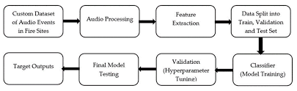
System Architecture
The image is a flowchart that shows the process of creating a custom dataset for audio events.
The first step is to define the target outputs, which are the sounds that you want the model to be able to identify.
Once you have defined the target outputs, you can start collecting audio data.
This data can come from a variety of sources, such as recordings from the real world or from online databases.
Once you have collected the audio data, you need to process it.
This typically involves extracting features from the audio data that will be used to train the model.
Some common features used for audio event detection include mel-frequency cepstral coefficients (MFCCs) and spectral flux.
Once the features have been extracted, the data is split into training, validation, and test sets.
The training set is used to train the model, the validation set is used to tune the hyperparameters of the model, and the test set is used to evaluate the performance of the model.
Finally, the model is trained on the training data.
Once the model is trained, it can be used to make predictions on new audio data.

Slide 11
System Requirements
Hardware Requirements:
- CPU : Processor i5 or more
- RAM : 8GB
- GPU : 2GB
-Operating System
Software Requirements:
-Kaggle Notebook
-Python 3.8

Slide 12
Non Functional Requirements
1. Low-Latency Detection:
- Achieve real-time scream identification through efficient audio signal processing.
- Minimize processing delays to ensure timely responses in emergency scenarios.
2. High Reliability:
- Utilize advanced machine learning algorithms for precise scream pattern recognition. - Implement adaptive models that account for various acoustic conditions, reducing false positive instances.
3. Scalable Integration:
- Design a system capable of handling varied audio input sources, from individual devices to larger-scale applications.
- Ensure flexibility for easy integration with different platforms and devices, enhancing its applicability.
4. Robust Performance:
- Employ sophisticated noise filtering techniques to maintain accuracy in diverse background environments.
- Fine-tune the system to handle variations in acoustic conditions, ensuring consistent performance across different scenarios.

Slide 13
Thank You

